Slide 1


ROBOTIC ARM
Electronics & Telecommunication
Engineering
Guided by Dr. Arunashu Mohapatro (Assoc. Prof.)
Group
Smruti Sucharita Mishra
Ashish Mohan Mohapatra
Kamal Kumar Sahu
(2002070070)
(2002070078)
(2103070007)

Slide 2
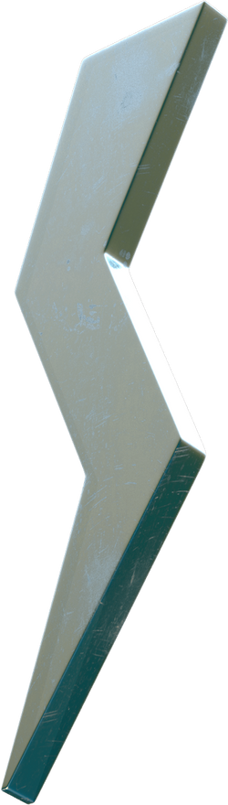
PROBLEM STATEMENT
INTRODUCTION
FEATURES
PARTS & COMPONENTS
CONTENTS
DESIGN & CONSTRUCTION
WORKING PRINCIPLE
ROBOTIC GLOVE & IT’S MODEL
CONCLUSION
SCOPE FOR FUTURE WORK
REFERENCES

Slide 3

PROBLEM STATEMENT
Imagine you are trapped in a place where you can't do the work by your hands , it may harm you, especially in industrial thermal power plants and chemical laboratories .
How to deal with this type situations?

Slide 4
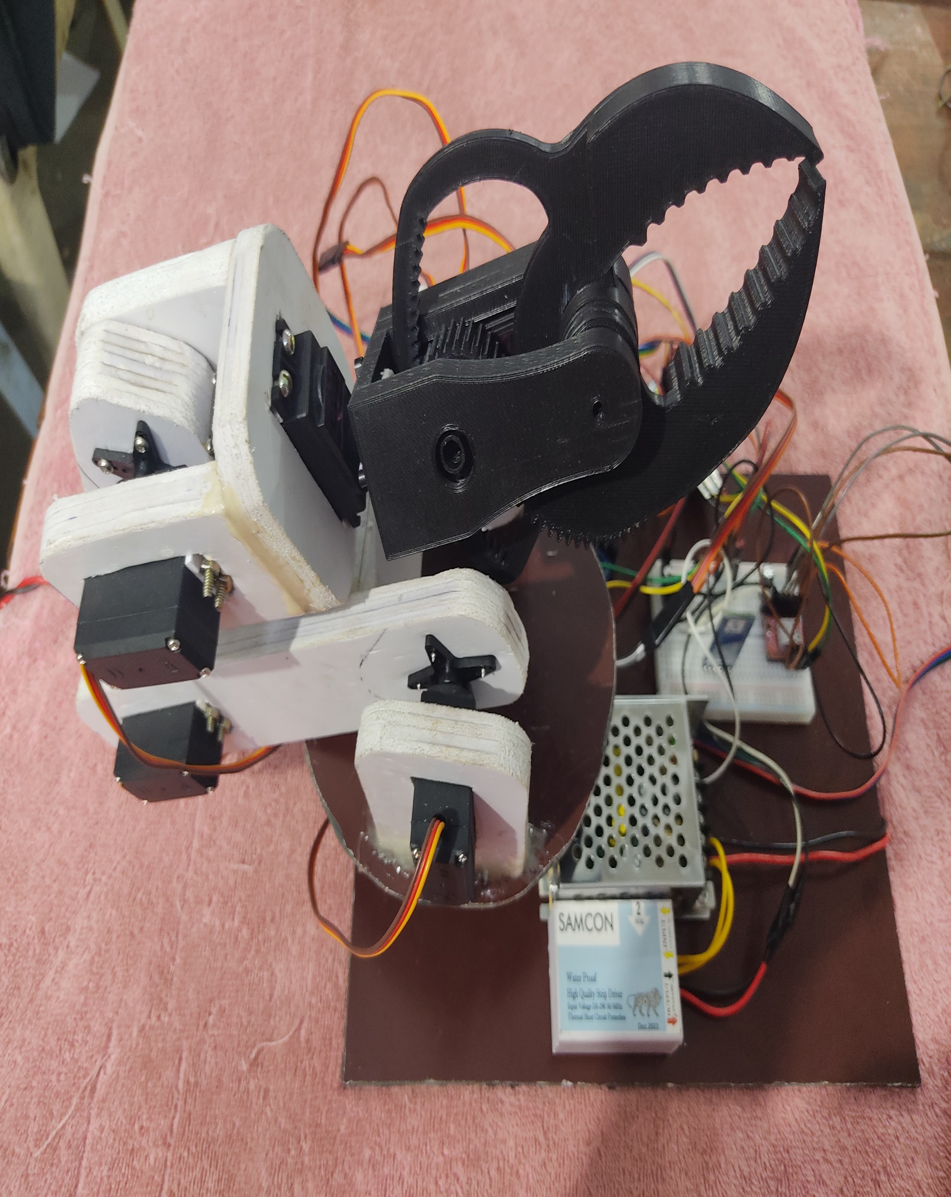
INTRODUCTION
Robotic arms, aptly named because they resemble a human arm, are typically mounted to a base.
The arm contains multiple joints that act as axes that enable a degree of movement.
The higher number of rotary joints a robotic arm features, the more freedom of movement it has.

Slide 5
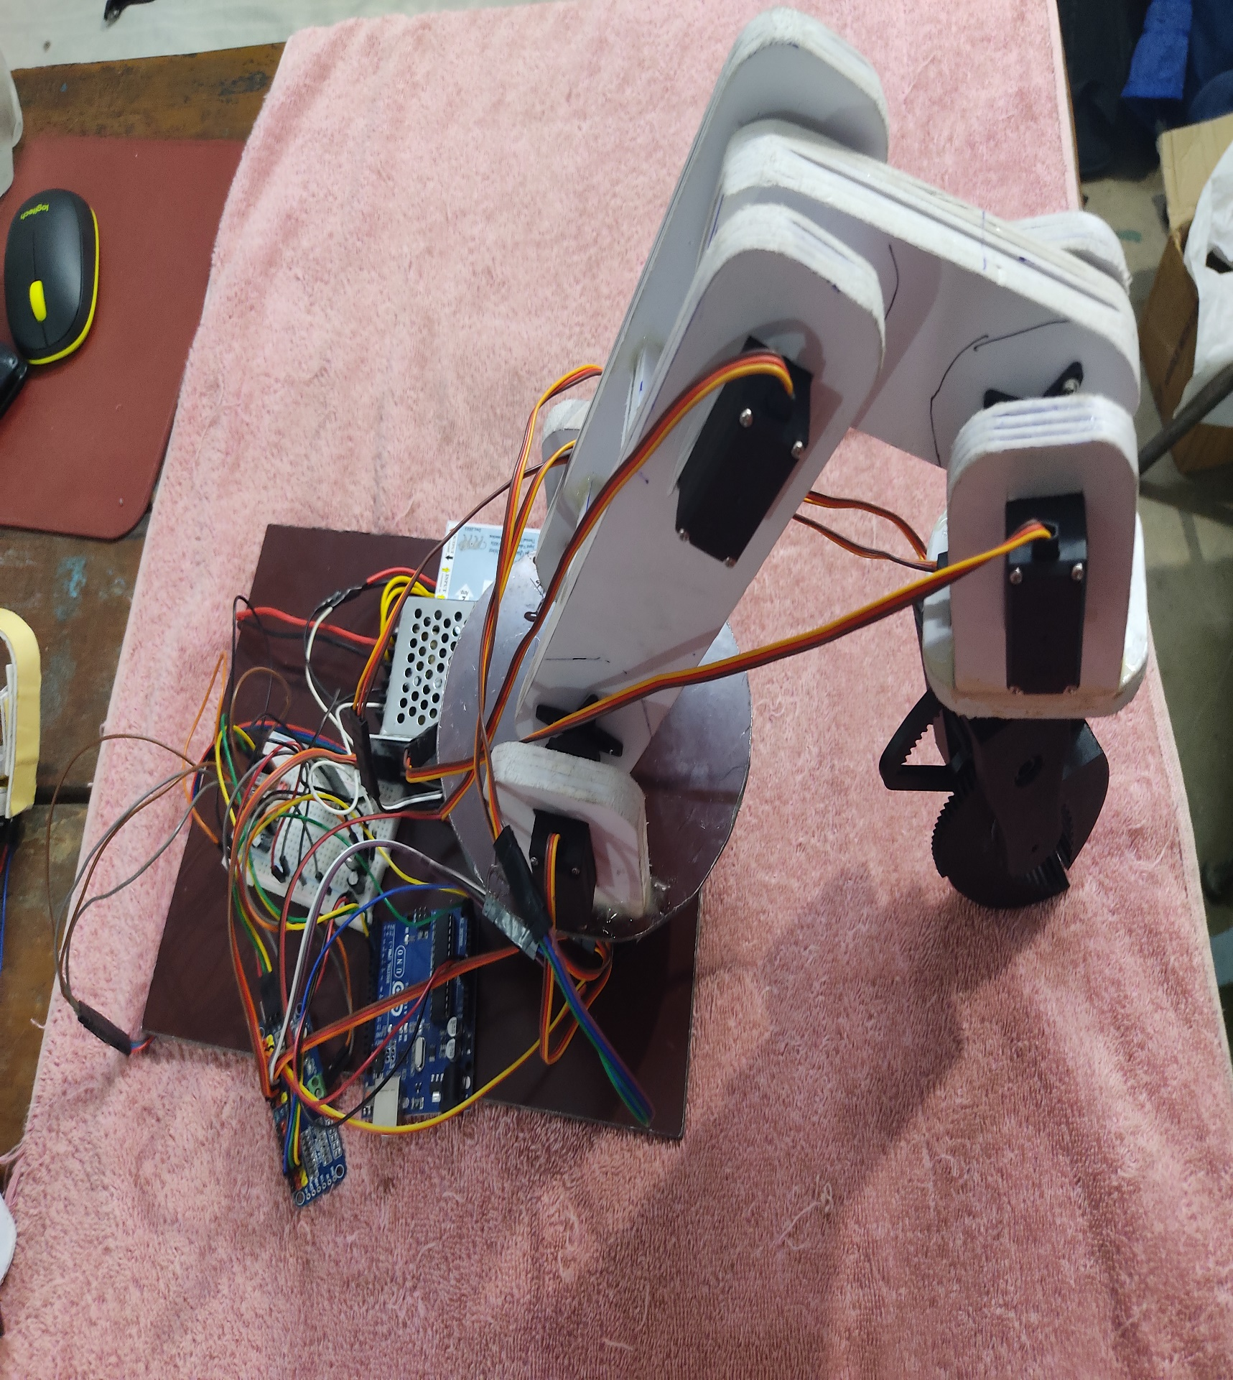
FEATURES
c
6 Axis Rotation
Portable
Control the Robot with Human Gestures
Can Be pre-programmed to carry out basic functions
Can be controlled wirelessly from a range
Can hold a load weight 600g (Max Load 1kg)

Slide 6
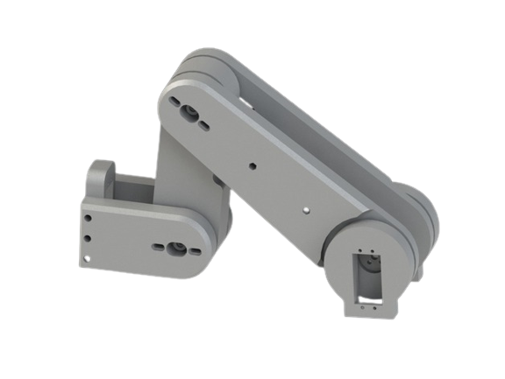
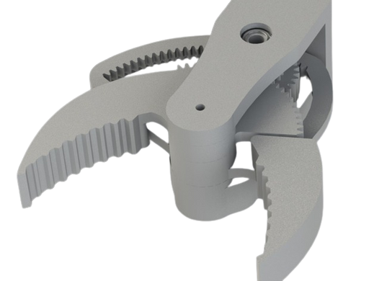
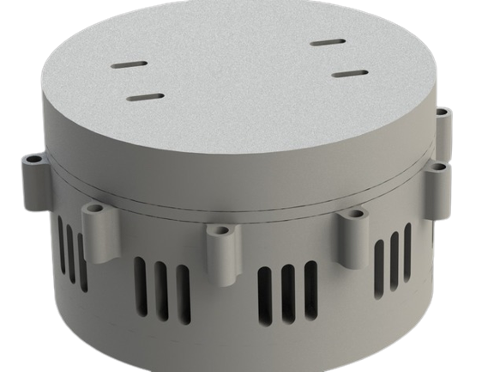
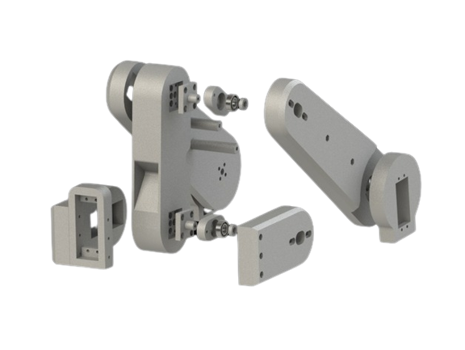
PARTS
Gripper Parts
Base and Turntable
Robotic Core Arm

Slide 7
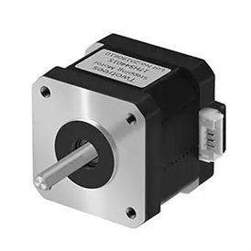
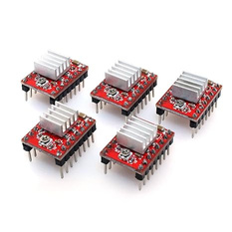
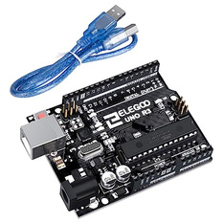
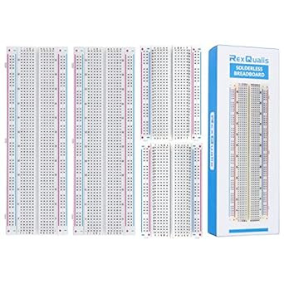
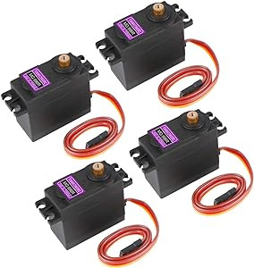
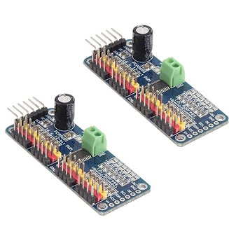
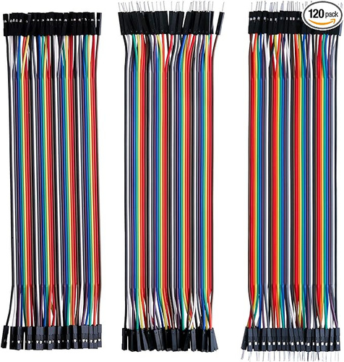
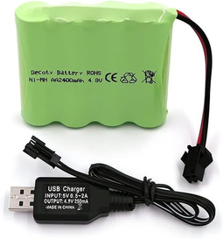
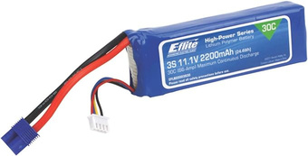
COMPONENTS
Stepper Motor
Stepper Motor Driver
Arduino Uno
Breadboard
Servo Motor
Servo Driver
LiPo 11.1V
2200mAh
Battery Pack
(5V, 2200 mAh)
Jumper Wires

Slide 8
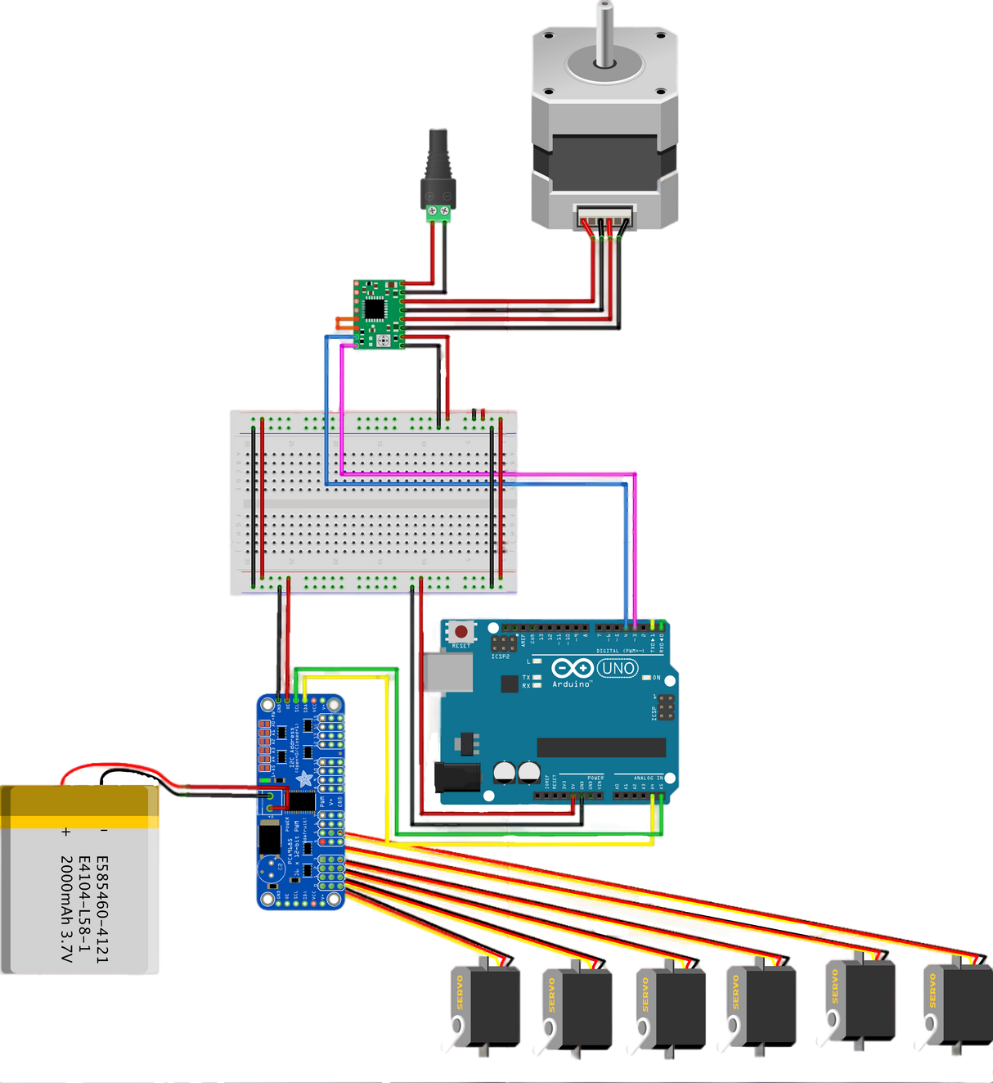

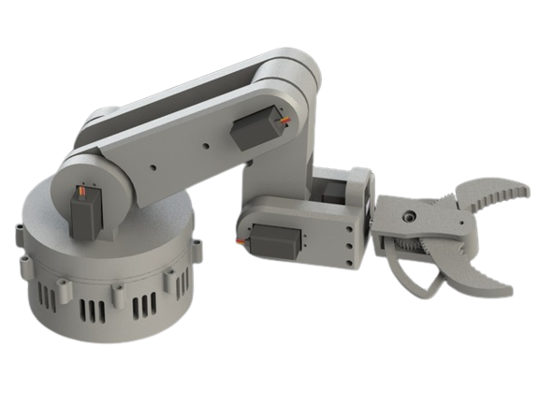
Design and Construction
Shoulder joint
Elbow joint
Wrist joint 2
Wrist joint 1
Gripper joint
Base joint

Slide 9
HOW IT WORKS ?
Controlled by Predefined Directions
The robotic arm can stand and turn around for some angle as mentioned in the code. To change the function or action again we have to change the code for direction and simulate it again.
Controlled by Hand Gesture [Using Bluetooth]
Another way of controlling the robot is using bluetooth , in this method we connect our hand to the robot via Bluetooth and gestures are monitored by flex sensor, accelerometer, then it mimic the hand gesture.

Slide 10
ROBOTIC GLOVE
Flex Sensor – Based on the bend of the finger, the current changes which we could use to send a signal to the Motor
Accelerometer (MPU6050) – We can control the Motor by mapping human gestures from X, Y, Z plane
LED – The LED will light up when a human gesture control has been sent to the Arduino
Bluetooth (HC-05) Module – Sending data to Robotic Arm HC-05 Receiver
Arduino Nano – The microcontroller would perform as the brains of the Robotic Glove

Slide 11
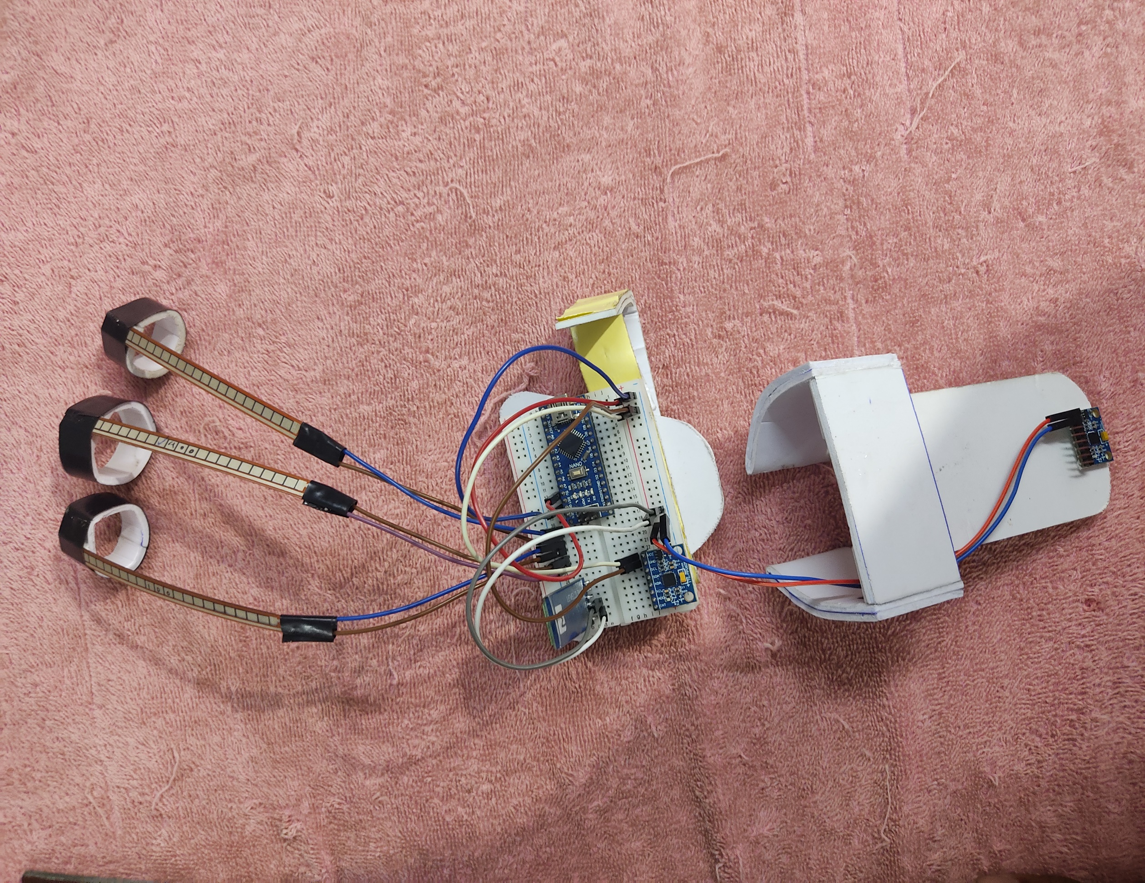
Model of hand glove

Slide 12
CONCLUSIONS
In conclusion, robotic arms offer unparalleled precision and efficiency across various industries, overcoming challenges with advancements in AI, collaboration, and adaptability, paving the way for a transformative future.

Slide 13
SCOPE FOR FUTURE WORK
The robotic arm can be :
More light weighted
Programmed using machine learning
so that for same type of instructions will be learned by the arm and performed without any effort.

Slide 14
REFERENCES
Priyambada Mishra, Riki Patel, Trushit Upadhyaya, Arpan Desai “Review of Development Of Robotic Arm Using Arduino UNO”, International Journal on Recent Researches in Science, Engineering and Technology, ISSN: 2348-3105 Volume 5, Issue 5, May 2017.
Puran Singh, Anil Kumar, Mahesh Vashishth “Design of Robotic Arm with Gripper and End effector for spot welding”, Universal Journal of Mechanical Engineering 1(3); 92-97, 2013, DOI: 10.13189/ujme,2013.010303.
Anughna N, Ranjitha V, Tanuja G “Design and Implementation of Wireless Robotic Arm Model using Flex and Gyro Sensor”, International Journal of Recent Technology and Engineering (IJRTE) ISSN: 2277-3878, Volume-8 Issue-5, January 2020.
Shamsheer Verma “Hand Gestures Remote Controlled Robotic Arm”, Advance in Electronic and Electric Engineering. ISSN 2231-1297, Volume 3, Number 5 (2013), pp. 601-606.
Gurudu Rishank Reddy and Venkata Krishna Prashanth Eranki “Design and Structural Analysis of a Robotic Arm” Blekinge Institute of Technology, Karlskrona, Sweden,

Slide 15
Thank You

